Slide 1
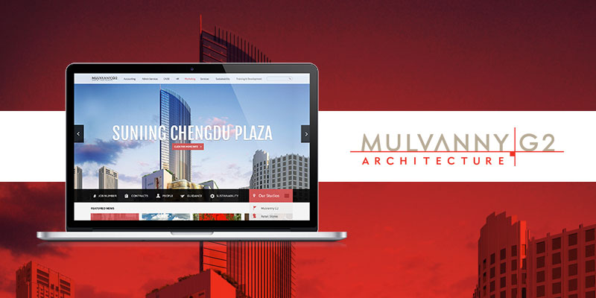
Mulvanny G2
The Challenge
Mulvanny Architecture came to Affirma needing a new SharePoint design site. The client&rsquo;s existing system gathered content from multiple sites and applications, so they wanted a way to organize all of their day-to-day needs into one centralized location. They also wanted us to create a community-like experience within the site that would showcase designers within the studios, displaying the designers&rsquo; strengths, helping project management and overall workflow.</p>
What We Did
<ul>
<li>Affirma used the opportunity with Mulvanny to deliver a simple and easy to use SharePoint. We worked closely with the client to identify their core content and put forth the best strategy for organizing their information.&nbsp;</li>
<br />
<li>We went through group sessions with Mulvanny to understand key functionality to implement new ideas and forward thinking methods. Following that we designed highly intuitive wireframes that allowed us to quickly visualize functionality while ensuring a great user experience.</li>
<br />
<li>While working thoroughly with Mulvanny in design focused meetings, we created a modern design taking elements of their brand to maintain a consistent look with all of the existing collateral.&nbsp;</li>
</ul>
Results
<p>The project was a great platform to showcase Affirmas expertise and capabilities. As a company full of designers and visually orientated individuals, Mulvanny was pleased with the overall polished design and experience. The whole Affirma team was a key part in creating a tool that brought the Mulvanny studios together with an online community experience.</p>

